Slide 1

MADAN MOHAN MALVIYA UNIVERSITY OF TECHNOLOGY GORKHPUR
Management Studies Department
2023-26
Case Study(Employee Retention Challenges)
BBA II Year
Vaishnavi Singh (71)
Vivek Singh (72)
UNDER THE SUPERVISION OF
Dr. Bharti Shukla
(Assistant professor)
MSD
Presented by:
Vivek Singh (73)
Yashmani Tripathi (74)
Zara Hayat (75)

Slide 2

Employee Retention Challenges

Slide 3

01
Company Overview
Problemn statement
Agenda
Key issue Identified
Root cause
Evaluation of current measures
Swot Analysis
Recommendations
Conclusion
Brainstorm /Q/a

Slide 4


Company Overview
02
XYZ Corporation: Mid-sized technology company
Industry turnover average: 15%
XYZ’s turnover in past 12 months: 25%
Notable employee complaints:
Lack of career advancement
Poor work-life balance
Insufficient recognition
HR initiatives already in place:
Bonuses
Flexible work hours
Recognition programs
Still, turnover remains high

Slide 5

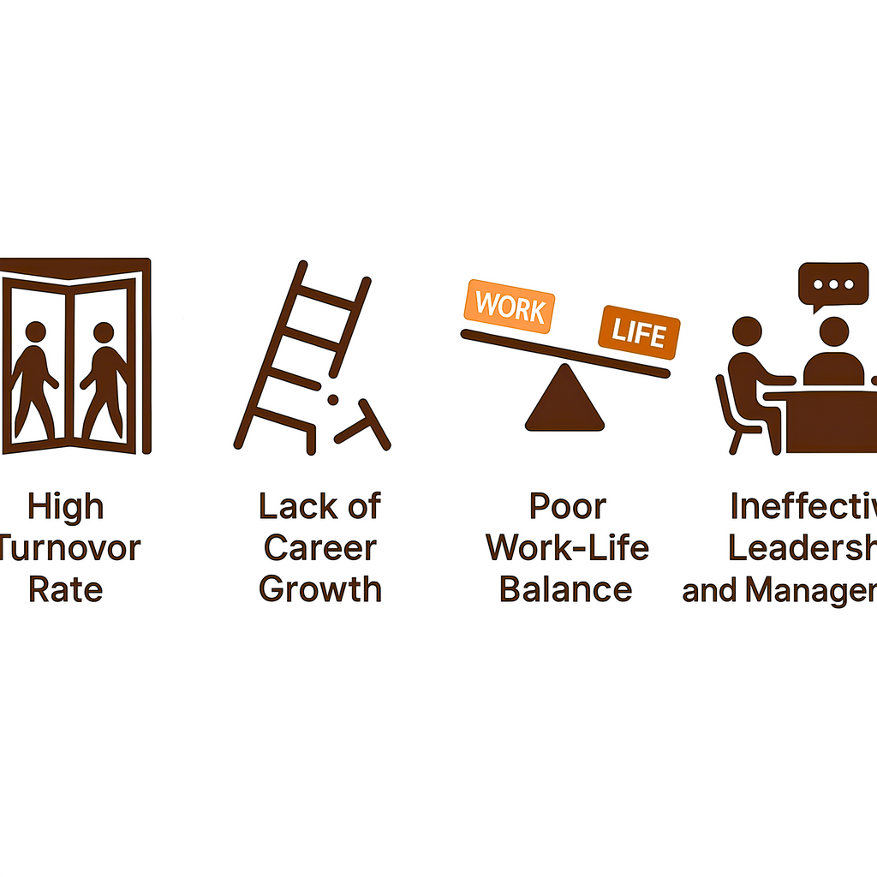
Problem Statement
03
High employee turnover rate
Xyz corporation is struggling with excessive turnover rate as compare to Average industry turnover i.e 25% .Current HR initiatives have failed to resolve the core concerns, which appear to stem from deeper organizational issues such as leadership gaps, limited growth opportunities, and misaligned company culture.

Slide 6
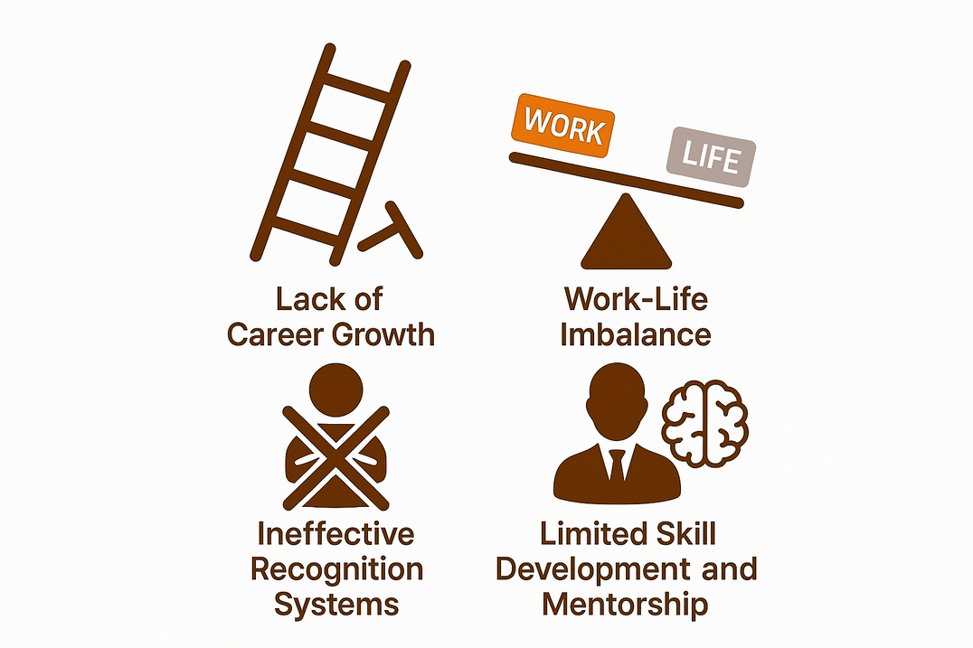

Key issues identified
04
Lack of Career Growth
Work-Life Imbalance
Ineffective Recognition Systems
Leadership and Management Shortcomings
Limited Skill Development and Mentorship

Slide 7
Root Cause Analysis
05
Issue | Underlying Cause
Career Stagnation | No clear career development pathways
Work-Life Conflict | Poor workload management
Lack of Recognition | Programs lack personalization or authenticity
Ineffective Leadership | Managers lack training and people skills
Culture Disconnect | Company values not reflected in everyday work

Slide 8
Current measures
06
Initiative | Outcome | Limitation
Bonuses | Temporary satisfaction | Doesn’t address core discontent
Flexible Hours | Some relief | Workload still heavy
Recognition | Minimal impact | Feels generic, not motivating
Exit Interviews | Good insights | No follow-through or change observed

Slide 9

SWOT
07
S (Strength) | W (Weaknesses) | O (Opportunities) | T (Threats)
Structured HR policies Financial capability for benefits | Weak leadership training Poor career development structure | Build internal talent pipelines | Competitors attracting talent Declining morale impacting innovation

Slide 10

Recommendations
08
Leadership Development program
Career Pathing & Skill Growth
Train managers on communication, motivation, and empathy
Offer mentorships, clear promotions, skill enhancement workshops
Work-Life Redesign
Meaningful Recognition
Reduce unrealistic workloads, introduce mental health support
Peer-nominated awards, personalized appreciation
Culture Alignment
Townhalls, anonymous feedback tools, culture ambassadors

Slide 11
Q/A Of case:
03
What do you think is the primary cause of high employee turnover rate at xyz corporation
Cause of employee turnover rate are following:
Lack of Career Growth Opportunities
Leadership & Management Issues
Poor Work-Life Balance
Lack of Meaningful Recognition
How would you assess the effectiveness of the company’s current employee retention strategies?what would you recommended they change or improve?
Current strategy Effectivness
Bonuses low
Flexible working hours Moderate
Employee recognition programs Low to Moderate
Exit interviews High

Slide 12
Q/A Of case:
03
Reccomandation:
Strengthen Leadership & Management Training
Create Clear Career Growth Opportunities
Enhance Workplace Culture & Engagement
What steps can HR take to address the leadership and skill development issues identified in the exit interviews?
Leadership Development Initiatives
Strengthen Employee Engagement & Retention Culture
Career Growth & Skill Development Programs

Slide 13
Q/A Of case:
03
How can XYZ corporation create better work life balance and improve employee recognition significantly increasing costs?
Work-Life Balance Improvements
Employee Recognition Enhancements
Should the company increase salaries or benefits to reduce turnover? Why or why not ?What other non financialstrategies could be more effective?
If exit interviews indicate pay is below industry standards, raising salaries could reduce turnover
Higher pay doesn’t address leadership, career growth, or work-life balance—the main reasons employees are leaving
Strengthen Career Development & Growth
Strengthen Employee Recognition & Culture
some non financial strategy

Slide 14

Conclusion
09
Turnover at XYZ is symptomatic of deeper organizational gaps
Money and perks alone won’t fix the issue
Sustainable retention requires a strategic focus on people
With the right leadership, growth opportunities, and culture, XYZ can become a top talent-retaining company

Slide 15



Thank You

